Slide 1
MetaROOT
Anney Che
Kimberley LeBlanc Takako Takeda
Preeti G. Kochar

Slide 2
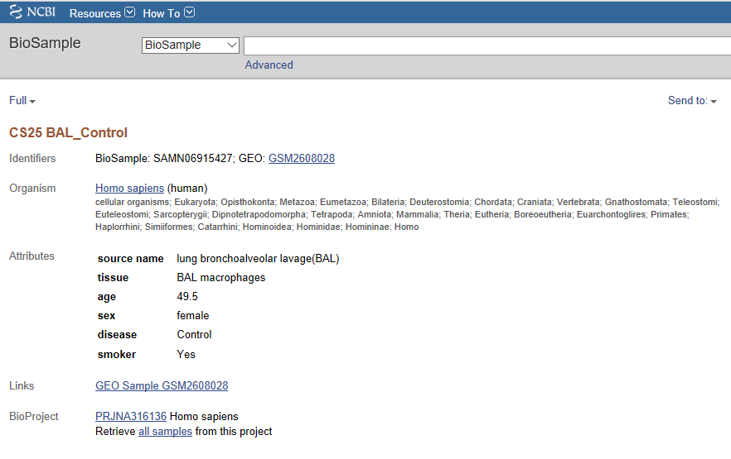
BioSample Example 1

Slide 3
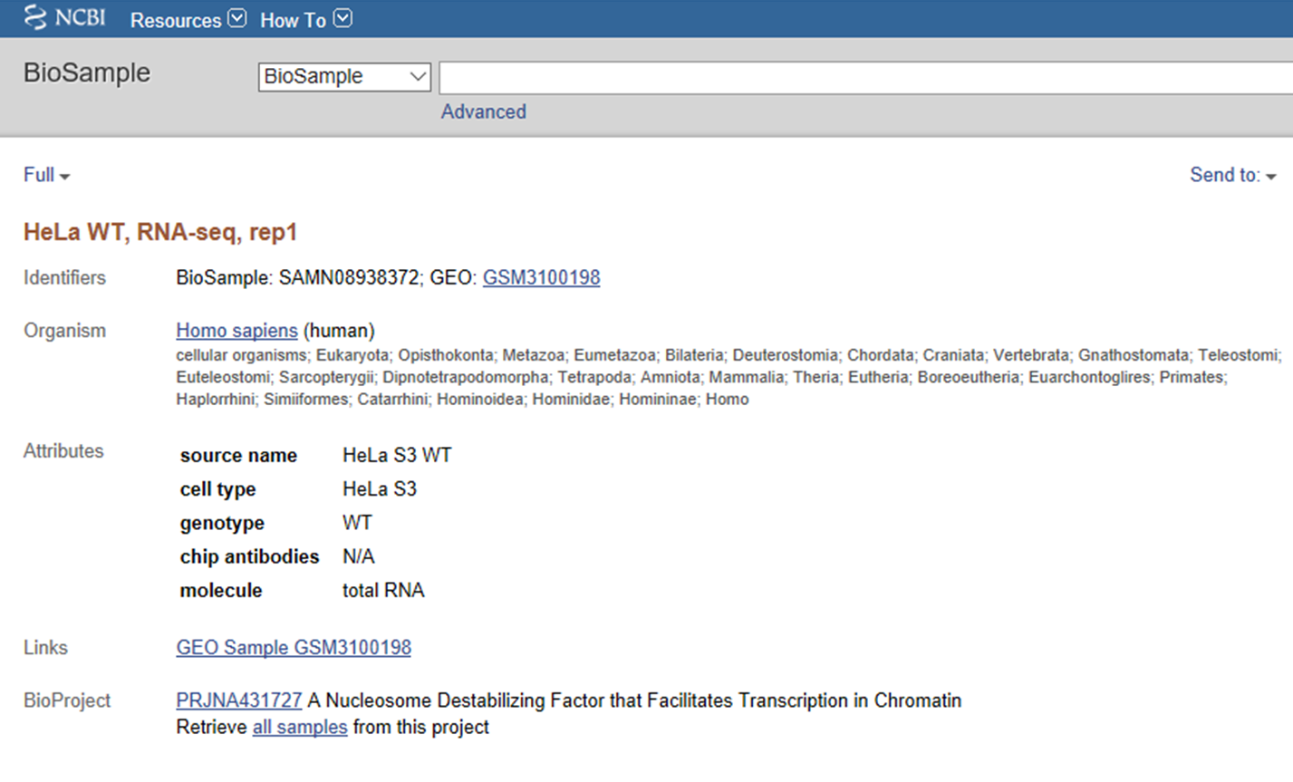
BioSample Example 2

Slide 4
Edirect Search:
./esearch -db bioSample -query "human [orgn]" | ./efetch -format docsum | ./xtract -pattern DocumentSummary -element Accession Attribute@attribute_name Attribute

Slide 5
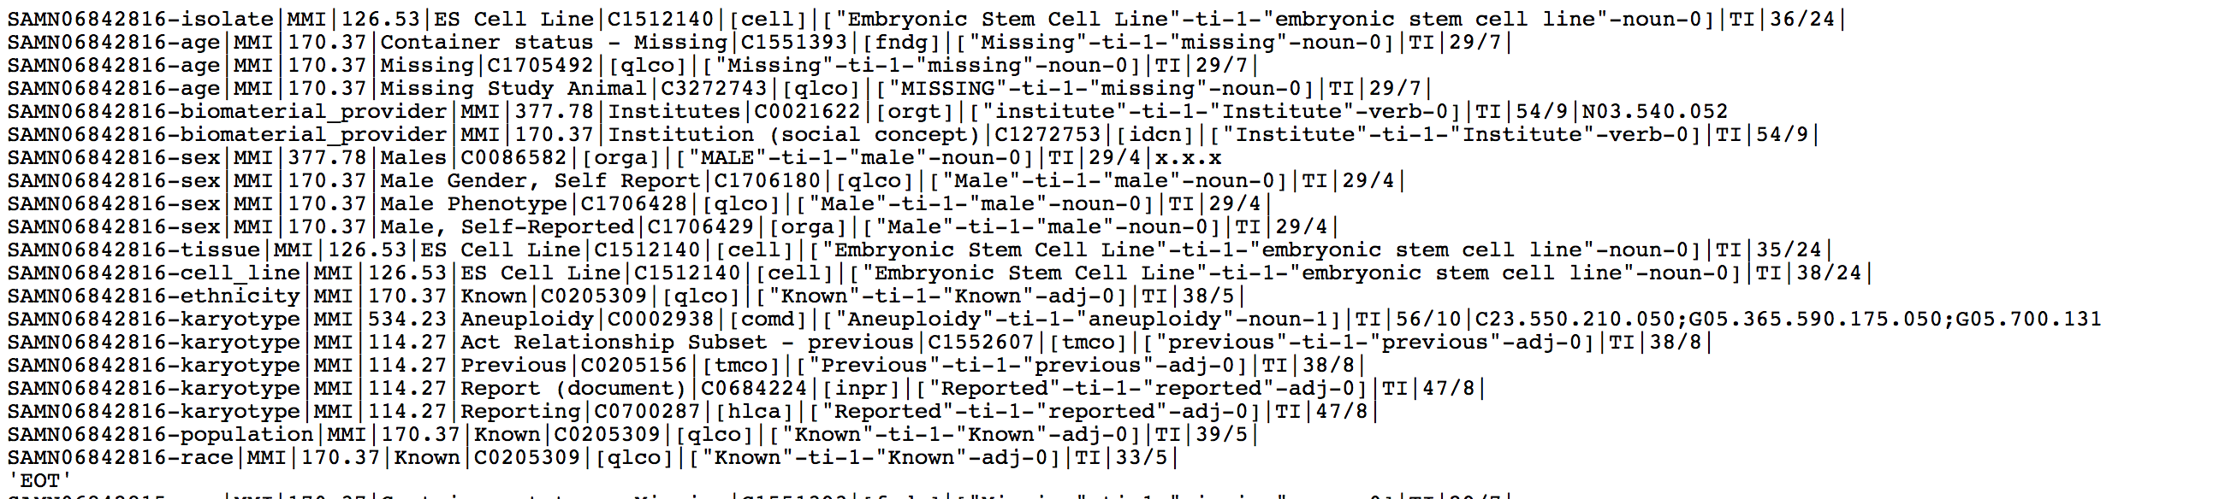
MetaMapLite Analysis

Slide 6
MetaMapLite Next Steps
To analyze the output of MetaMap terms:
Remove Stop Words
Focus on Diseases?

Slide 7
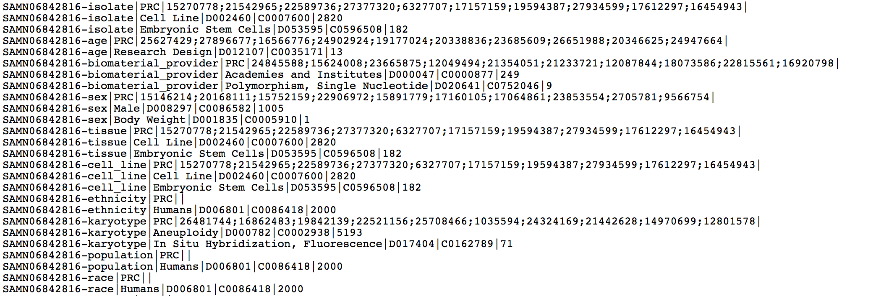
MeSH on Demand Analysis

Slide 8
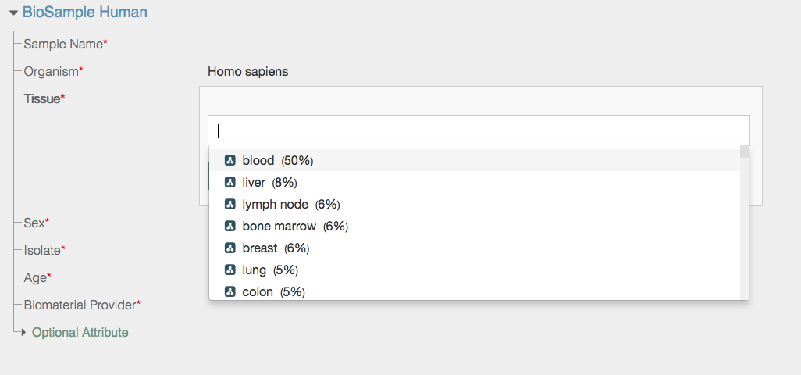
Cedar has resources for BioSample

Slide 9
Use Case: Polycystic Ovary Syndrome
Edirect search: esearch -db bioproject -query "polycystic ovarian syndrome" | efetch -format docsum | xtract -pattern DocumentSummary -element Project_Acc Project_Description > Downloads/PCOS_BioProject_Descriptions_v2

